Slide 1


Intermediate Python
Class Coding Basic

Slide 2
Class Objects & Instances
A class defines a blueprint; an instance is a concrete object created from it.
A class defines structure and behavior
An instance represents real data
Multiple instances share the same class
Attributes belong to instances or the class
Instances are created using the class name
Notes:
Emphasize the blueprint vs object analogy. Each instance has its own data but the same behavior.

Slide 3
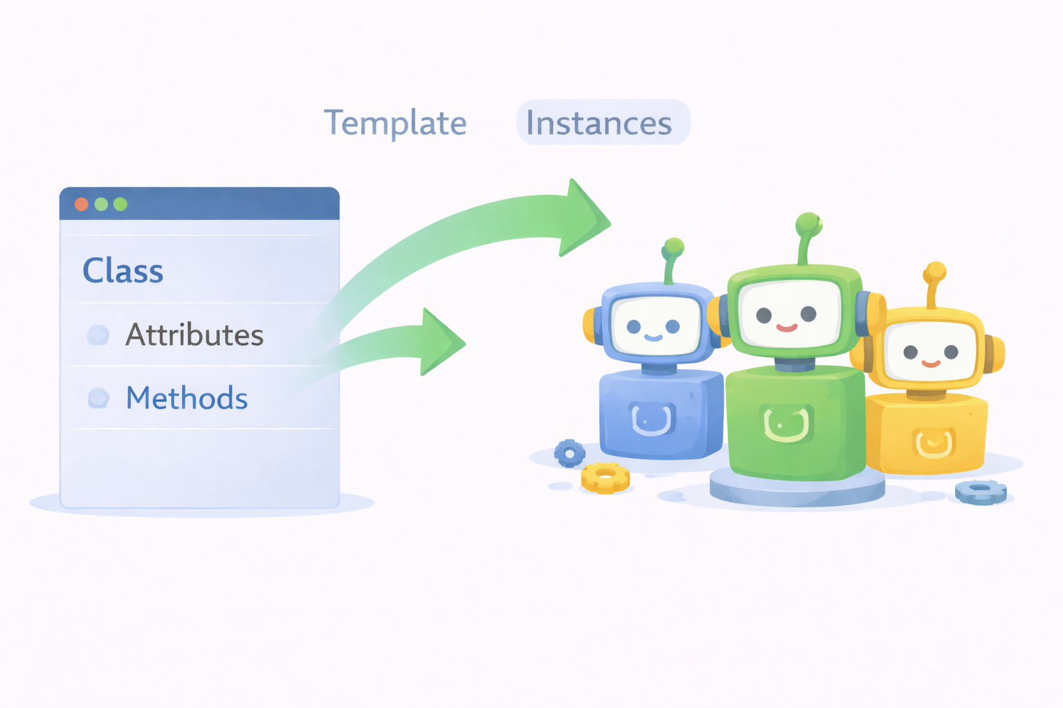

Slide 4
Source Code Example
class Person:
pass
p1 = Person()
p2 = Person()
print(type(p1)) # <class '__main__.Person'>

Slide 5
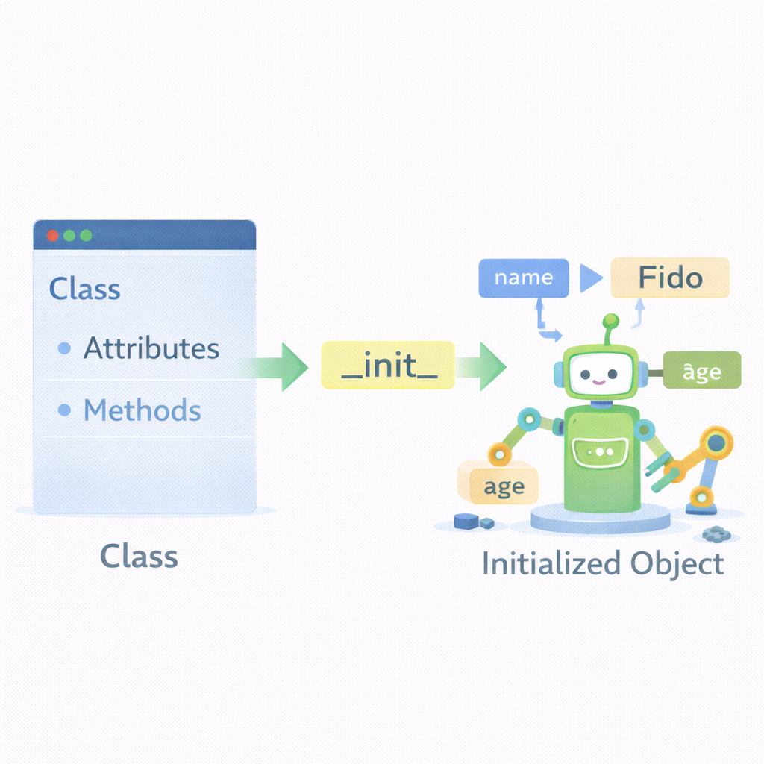
Constructors (__init__)
The constructor initializes an object’s state when it is created.
__init__ runs automatically on creation
Used to assign initial values
self refers to the current instance
Can perform validation
Defines required data for the object
Notes:
Explain that self is explicit in Python. Good constructors prevent invalid objects.

Slide 6
Source Code Example
class Person:
def __init__(self, name, age):
self.name = name
self.age = age
p = Person("Aina", 20)

Slide 7

Methods
Methods define the behavior of objects.
Methods are functions inside a class
First parameter is always self
Operate on instance data
Encapsulate behavior with data
Improve code organization
Notes:
Reinforce that methods access data via self. This is what makes OOP powerful.

Slide 8
Source Code Example
class Person:
def __init__(self, name):
self.name = name
def introduce(self):
print(f"Hi, I am {self.name}")
p = Person("Ali")
p.introduce()

Slide 9
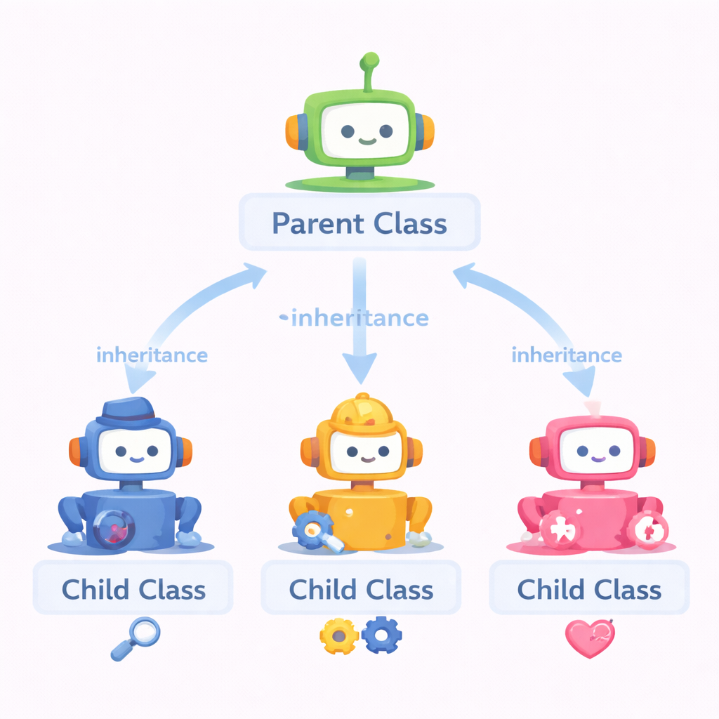
Inheritance Basics
Inheritance allows a class to reuse and extend another class.
Child class inherits from parent class
Reduces code duplication
Child can add new behavior
Child can override existing behavior
Models “is-a” relationships
Notes:
Ask students which methods come from the parent. Stress reuse without copy-paste.

Slide 10
Code example
class Person:
def introduce(self):
print("I am a person")
class Student(Person):
def study(self):
print("I am studying")
s = Student()
s.introduce()
s.study()

Slide 11
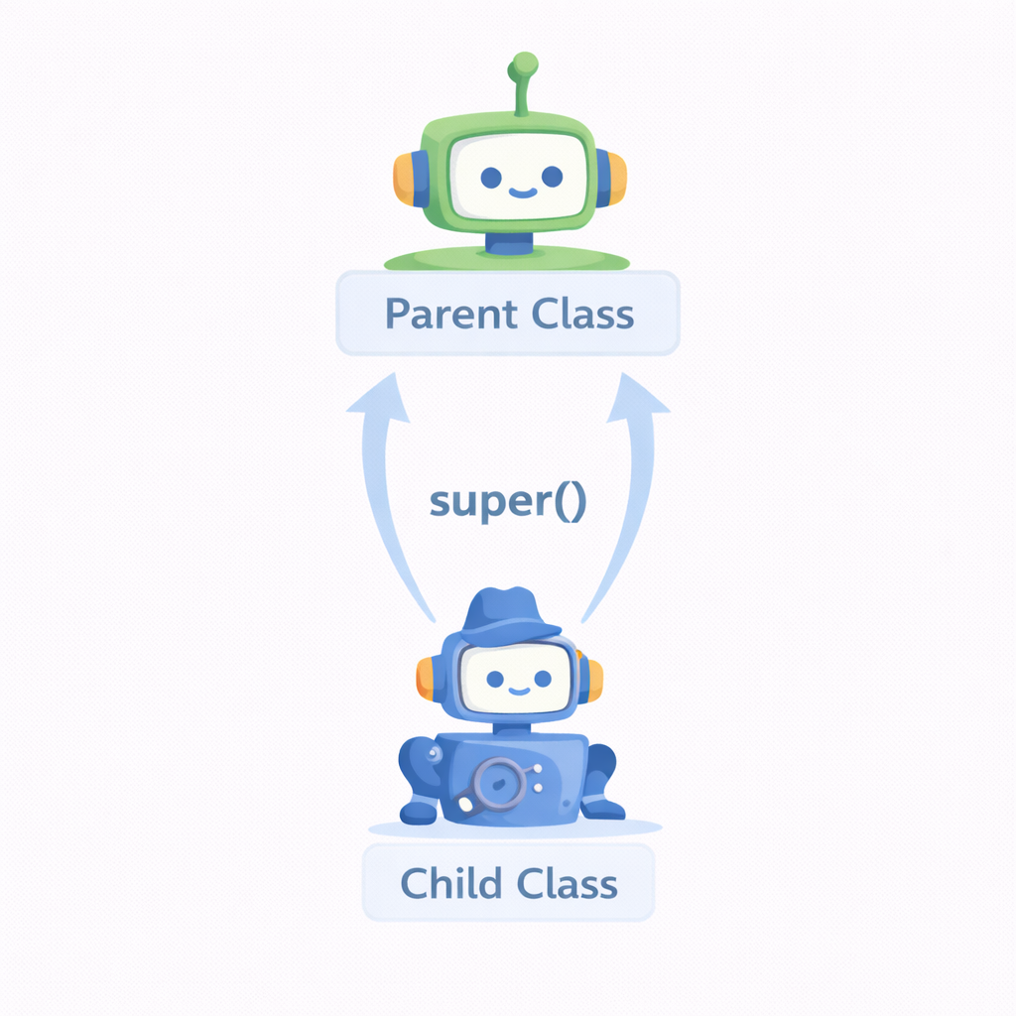
Using super()
super() allows child classes to reuse parent class logic.
Calls methods from the parent class
Commonly used in constructors
Prevents duplicated initialization code
Works correctly with inheritance chains
Safer than calling parent class directly
Notes:
Explain that super() follows Python’s method resolution order (MRO). Avoid hard-coding parent class names.

Slide 12
Code Example
class Person:
def __init__(self, name):
self.name = name
class Student(Person):
def __init__(self, name, student_id):
super().__init__(name)
self.student_id = student_id

Slide 13
Operator Overloading: Introduction
Operator overloading lets objects respond to operators like +, ==, and <.
Operators map to special methods
+ → __add__
== → __eq__
Makes objects feel like built-ins
Must behave intuitively
Notes:
This is an introduction only—details come later. Stress responsible use of operator overloading.

Slide 14
Source Code Example
class Counter:
def __init__(self, value):
self.value = value
def __add__(self, other):
return Counter(self.value + other.value)
c1 = Counter(3)
c2 = Counter(5)
c3 = c1 + c2

Slide 15
Class Coding Best Practices
Well-designed classes are easier to read, test, and extend.
One clear responsibility per class
Use meaningful method names
Validate inputs early
Prefer composition over deep inheritance
Keep behavior predictable
Notes:
Connect best practices to maintainability and teamwork. Bad class design scales poorly.

Slide 16
Class Coding Basics: Summary
Classes combine data and behavior into reusable, structured units.
Classes define structure
Instances hold real data
__init__ initializes objects
Methods define behavior
Inheritance and operators extend power
Notes:
Bridge to next topic: deeper operator overloading and advanced class design. Encourage students to think in objects, not functions.

